Slide 1
Getting Started with OpenShift for Developers
Openshift 101
Arslan Khan
Solution Architect
Notes:
This workshop is intended to give you a hands-on introduction to using OpenShift from the perspective of a developer.

Slide 2

AGENDA
INTRODUCTION
13:00→ 15:00
MicroServices
Kubernetes
OpenShift
Demo
Parkmap Application
App delivery on OpenShift
OpenShift Pipelines
OpenShift GitOps

Slide 3
Why Microservices ?
Notes:
Before we start the workshop, we’ll provide a brief introduction to Kubernetes and OpenShift.
The instructor can demo any of kubectl commands here, rather than having all the attendees follow along. Those commands can also be skipped in the interest of time.
Introduction to Kubernetes and OpenShift
Why do we need Kubernetes?
Overview of what Kubernetes is and what it is not
Interacting with Kubernetes via the API and kubectl
Overview of basic Kubernetes resources
What is OpenShift and how does it relate to Kubernetes?

Slide 4
The Monolith Application
OpenShift 101
Notes:
Traditional monolithic application, containing different macro-components inside e.g. frontend, backend, etc
Tightly coupled lifecycle
Logical separation through different Modules

Slide 5
Microservices
Notes:
Microservice approach explodes this concept into different autonomous units. Each component/module is now a separate process.
deployed in heterogeneous conditions
Loose coupling of lifecycle
Each component can have different language, Java, Python

Slide 6
Network of Services
Notes:
Microservices now need to be interconnected, each dependencies is addressed with a communication mechanism such as REST API call or queues.

Slide 7
Microservices own their Data
Notes:
The database itself is not unique and schema is distributed across each microservice responsible for that specific part.
Some insert data Some manipulating data Some fetch data With so many moving parts , there was a need for a management technology

Slide 8
Why Kubernetes ?
Notes:
Before we start the workshop, we’ll provide a brief introduction to Kubernetes and OpenShift.
The instructor can demo any of kubectl commands here, rather than having all the attendees follow along. Those commands can also be skipped in the interest of time.
Introduction to Kubernetes and OpenShift
Why do we need Kubernetes?
Overview of what Kubernetes is and what it is not
Interacting with Kubernetes via the API and kubectl
Overview of basic Kubernetes resources
What is OpenShift and how does it relate to Kubernetes?

Slide 9
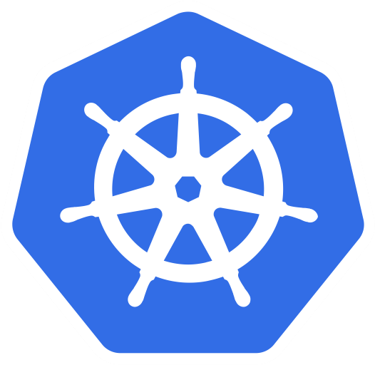
What is Kubernetes?
An open source orchestration system for managing containerized workloads across a cluster of nodes.
Notes:
So what is it?
Kubernetes is an open-source platform for managing containerized workloads - at scale. As a container orchestration system, it can help you automate application deployment, scaling, and management. In other words, you can cluster together groups of machines or hosts running containers, and Kubernetes will help you easily and efficiently manage those clusters.
A Kubernetes cluster ends up running different Kubernetes objects - things like Pods, Services, Deployments, etc.

Slide 10
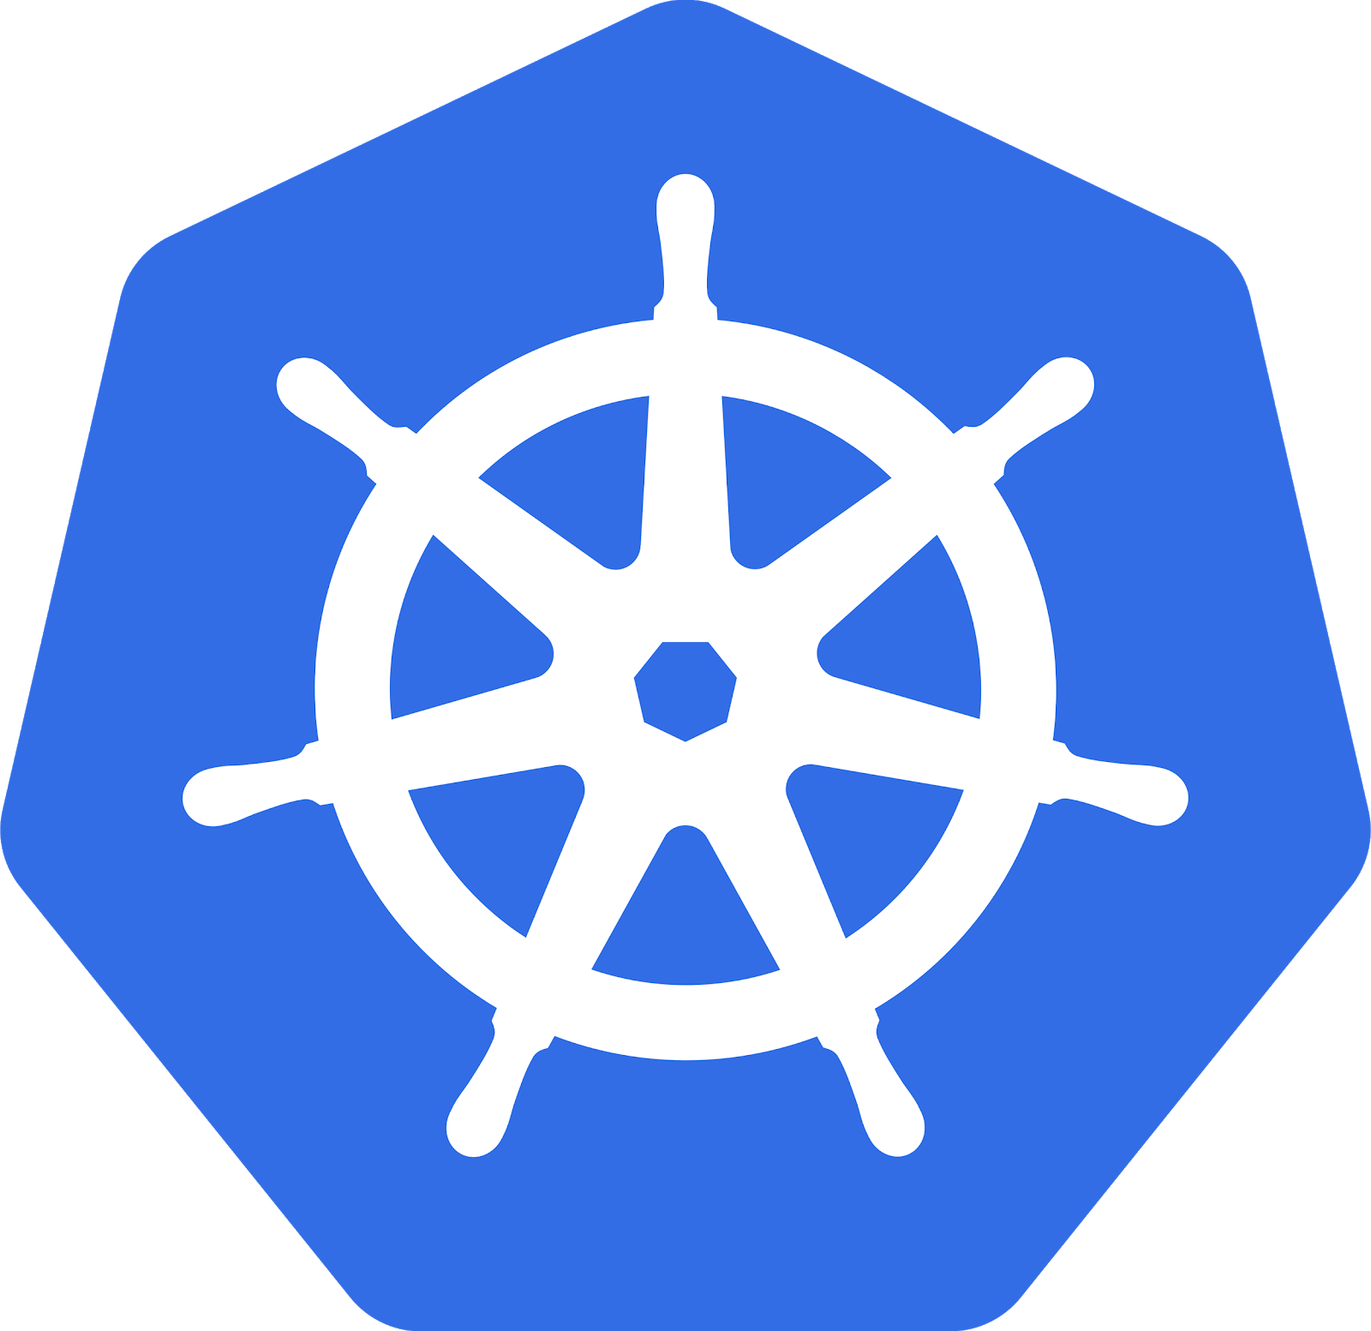

Old School New School
Love Thy Mono
Notes:
The evolution of the Monolith approach is a Microservices mesh enabled and enhanced by a container orchestration platform such as Kubernetes and OpenShift

Slide 11
Understanding Kubernetes Objects
Kubernetes objects are persistent entities that represent the desired state of your cluster that you can manage with the K8s API
Notes:
Kubernetes objects are persistent entities that represent the state of your cluster that you can manage with the K8s API

Slide 12
Understanding Kubernetes Objects
Pod
ReplicaSet
Deployment
Secret
Namespace
ConfigMap
Service
PersistentVolume
Notes:
This is a list of some of the most common objects Kubernetes implements.
You work with them using the Kubernetes API.
Kubernetes uses these objects to represent the state of your cluster. They work as a “record of intent” – once you create the object, the Kubernetes system will constantly work to ensure that object exists. By creating an object, you’re effectively telling the Kubernetes system what you want your cluster’s workload to look like; this is your cluster’s desired state.

Slide 13
Kubernetes provides an API
API object primitives include these:
kind
apiVersion
metadata
spec
status
Notes:
Kubernetes provides a REST-based API, and the API object primitives typically include at least these 5 fields. Kind represented the kind or type of resource: Pod, service, deployment, etc.
Metadata can contain things like name and labels
The spec represents your desired state, and the cluster will return back the status.
You can interact with a cluster via the API directly, or using a command line tool like kubectl, which is a wrapper for the API.

Slide 14

Deployment
kind: Deployment apiVersion: apps/v1 metadata: name: hello-k8s creationTimestamp: labels: run: hello-k8s spec: Replicas: 2 selector: matchLabels: run: hello-k8s template: metadata: creationTimestamp: labels: run: hello-k8s spec: containers: - name: hello-k8s image: jkleinert/nodejsint-workshop resources: {} strategy: {} status: {}
Helps you specify container runtime, in terms of pods
Notes:
Normally you don’t spin up a pod manually like that though. To really take advantage of some of the benefits of kubernetes like the scaling and autorecovery or self-healing you need an object like deployments. Deployments help you specify container runtime, in terms of pods.
See that our deployment spec tells the number of replicas. And it has an embedded template with the container spec.

Slide 15

Pod
kind: Pod
apiVersion: v1
metadata:
creationTimestamp:
name: hello-k8s
labels:
run: hello-k8s
spec:
containers:
- name: hello-k8s
image: jkleinert/nodejsint-workshop
ports:
- containerPort: 8080
resources: {}
A group of one or more co-located containers
Minimum unit of scale
Notes:
Next let’s look at Pods. A pod is a group of one or more co-located containers. Most of the time you’ll have one container per Pod, but there are cases where you may have more than one. Pods are the minimum unit of scale in kubernetes. Pods get scheduled to run on nodes.
Here’s a sample pod spec. You can see those fields we talked about - kind, metadata, etc. and in the container spec, you can see the image that we want to run.

Slide 16

Service
kind: Service
apiVersion: v1
metadata:
name: hello-k8s
creationTimestamp:
labels:
run: hello-k8s
spec:
ports:
- protocol: TCP
port: 8080
targetPort: 8080
selector:
run: hello-k8s
type: NodePort
status:
loadBalancer: {}
Acts as a single endpoint for a collection of replicated pods
Like a load balancer
Notes:
"Services can help with that. A service acts as a single endpoint for a collection of replicated pods. You can think of it as a load balancer. The Service resource uses label selectors to discover where traffic should be directed
Note that services exist independently from pods - they have disjoint lifecycles.
Look at the service YAML - note the selector of run: hello-k8s in the spec.

Slide 17
Self Healing
Notes:
Before we start the workshop, we’ll provide a brief introduction to Kubernetes and OpenShift.
The instructor can demo any of kubectl commands here, rather than having all the attendees follow along. Those commands can also be skipped in the interest of time.
Introduction to Kubernetes and OpenShift
Why do we need Kubernetes?
Overview of what Kubernetes is and what it is not
Interacting with Kubernetes via the API and kubectl
Overview of basic Kubernetes resources
What is OpenShift and how does it relate to Kubernetes?

Slide 18






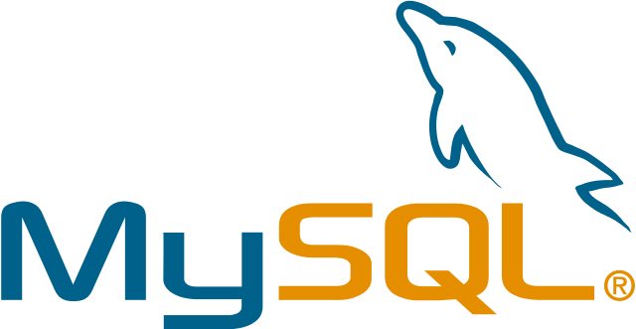
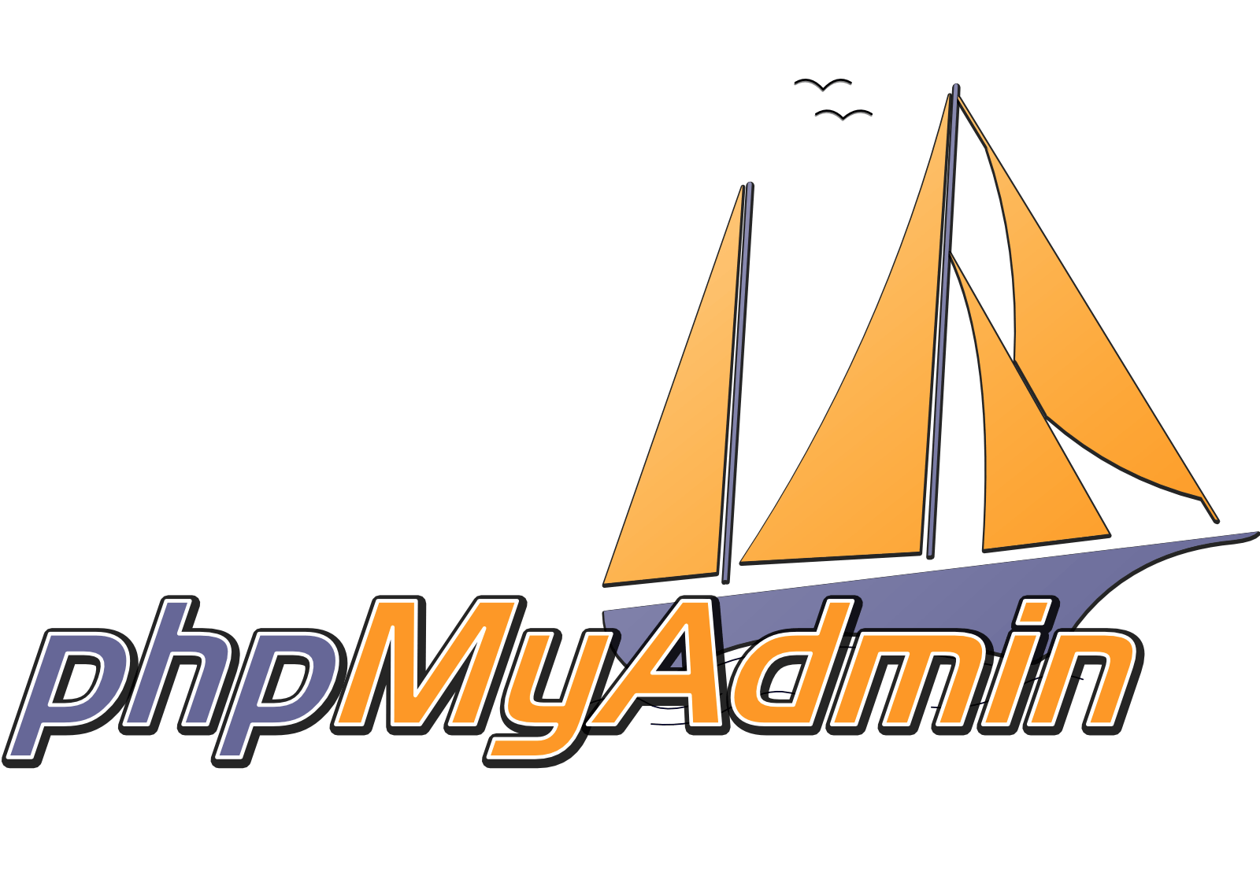
Kubernetes Cluster - 4 Tomcats
Node
kubelet
Node
kubelet
Node
kubelet
Node
kubelet
Node
kubelet
Node
kubelet
Istio proxy
Notes:
Example of deploying 4 replicas of tomcat java apps

Slide 19
Kubernetes Cluster - Pod Fail
Node
kubelet
Node
kubelet
Node
kubelet
X
Node
kubelet
Node
kubelet
Node
kubelet
Istio proxy
Notes:
When one Pod fails, Kubernetes recognize this failure

Slide 20
Kubernetes Cluster - Correcting
Node
kubelet
Node
kubelet
Node
kubelet
Node
kubelet
Node
kubelet
Node
kubelet
Istio proxy
Notes:
Kubernetes reacts immediately and move the failed pod to another suitable place such as another Node or restart it in the same one if that is OK.

Slide 21
Kubernetes Cluster - Node Fail
Node
kubelet
Node
kubelet
Node
kubelet
X
Node
kubelet
Node
kubelet
Node
kubelet
Istio proxy
Notes:
When a whole Node fails then Kubernetes will drain all Pods to another node

Slide 22
Kubernetes Cluster - Pods Replaced
Node
kubelet
Node
kubelet
Node
kubelet
Node
kubelet
Node
kubelet
Istio proxy
Notes:
So that the app continue to work gracefully, and OpenShift can also create automatically a new Node when the Provider supports it.

Slide 23
What is OpenShift?
Notes:
Before we start the workshop, we’ll provide a brief introduction to Kubernetes and OpenShift.
The instructor can demo any of kubectl commands here, rather than having all the attendees follow along. Those commands can also be skipped in the interest of time.
Introduction to Kubernetes and OpenShift
Why do we need Kubernetes?
Overview of what Kubernetes is and what it is not
Interacting with Kubernetes via the API and kubectl
Overview of basic Kubernetes resources
What is OpenShift and how does it relate to Kubernetes?

Slide 24
certified
Notes:
For those who may not be familiar with openshift. Quick overview

Slide 25
Cluster services
Application services
Developer services
Service mesh
Automated operations
certified
Enterprise Linux
Notes:
Lacks many essential components
Operating system
Container runtime (CRI-O, Containerd, Docker, etc).
Image registry
Software-defined networking
Load‐balancer and routing
Log management
Container metrics and monitoring
DNS
Load balancing
Ingress
RBAC

Slide 26

Cluster services monitoring, showback, registry, logging
Application services
middleware, functions, ISV
AI Services
Developer services
dev tools, automated builds, CI/CD, IDE
Service mesh
Automated operations
certified
Enterprise Linux CoreOS
Physical
Virtual
Private
Public
Any infrastructure
Notes:
AI

Slide 27
Enterprise Support and Security
Cluster services monitoring, showback, registry, logging
Application services
middleware, functions, ISV
AI Services
Developer services
dev tools, automated builds, CI/CD, IDE
Service mesh
Automated operations
certified
Enterprise Linux CoreOS
Physical
Virtual
Private
Public

Slide 28

What is a
Container ?
We will be using Containers in our demo
CONTAINERS
Notes:
Container technology is the most suitable option to create and distribute microservices across dev environments and clouds.

Slide 29
OPENSHIFT & KUBERNETES CONCEPTS
a container is the smallest compute unit
CONTAINER

Slide 30
Anatomy of a Dockerfile
OPENSHIFT & KUBERNETES CONCEPTS
FROM registry.access.redhat.com/ubi8/ubi
1
Inherit from a base image
ENV foo=text
2
Parameters as environment variables
RUN dnf install -y java-11-openjdk
3
Install dependencies (tooling from base image)
ADD my-app.jar /home/my-app.jar
4
Add your app as a new Layer
EXPOSE 8080
5
Expose the port your app will use
CMD java -jar /home/my-app.jar
6
Run the app
Example for Java app

Slide 31
OPENSHIFT & KUBERNETES CONCEPTS
container images are stored in an image registry
IMAGE REGISTRY
IMAGE
IMAGE
IMAGE
CONTAINER
IMAGE
IMAGE
IMAGE
Notes:
Git LAB ! Quay

Slide 32
OPENSHIFT & KUBERNETES CONCEPTS
an image repository contains all versions of an image in the image registry
IMAGE REGISTRY
myregistry/frontend
myregistry/mongo
frontend:latest
frontend:2.0
frontend:1.1
frontend:1.0
mongo:latest
mongo:3.7
mongo:3.6
mongo:3.4
IMAGE
IMAGE
IMAGE
IMAGE
IMAGE
IMAGE
IMAGE
IMAGE
Notes:
https://catalog.redhat.com/en/search?searchType=Containers&partnerName=MongoDB

Slide 33
Demo
OpenShift

Slide 34
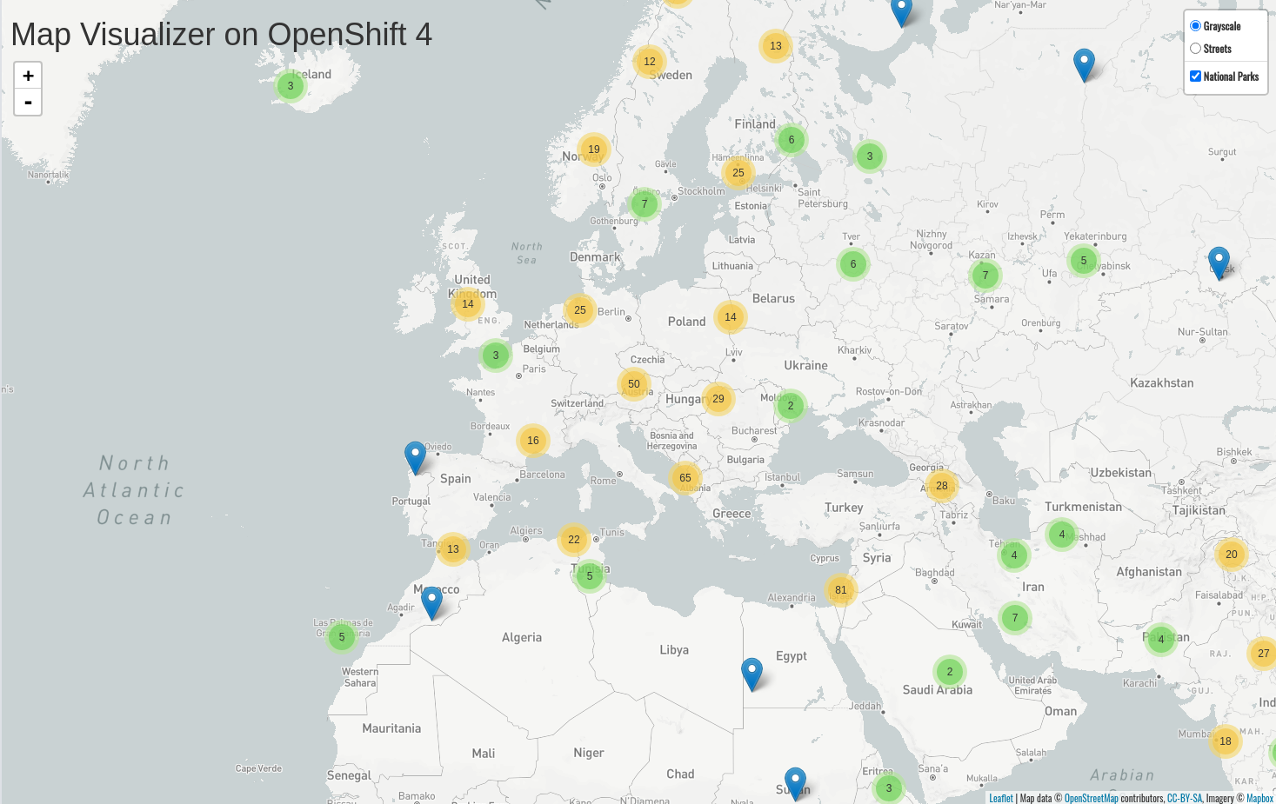
Map that shows National Parks

Slide 35
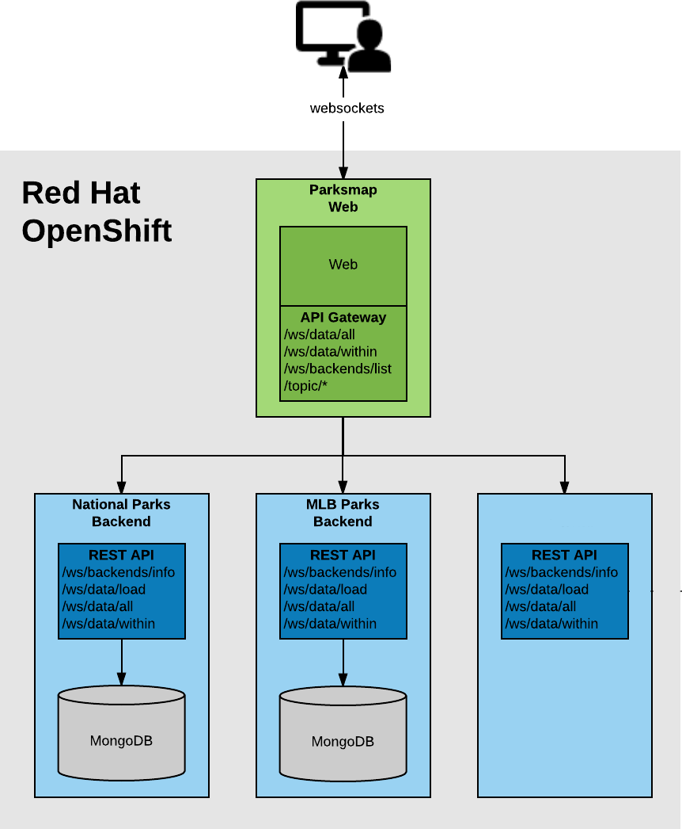
Parksmap Architecture
Has 3 components:
Frontend
Backend
Database
Notes:
We have a microservices based architecture composed by
One Frontend
A common API REST calls interface implemented as embedded API Gateway inside the Frontend
N Backends implementing the API REST to exchange the data with the Frontend

Slide 36
Parksmap Architecture
1- Frontend:
Spring boot frontend using Mapbox Javascript API to display a World map with data points
Labels:
app=workshop
component=parksmap
role=frontend
Notes:
Mention the API

Slide 37
Parksmap Architecture
2 - Backend:
Backend to show worldwide National Parks
Using MongoDB Database to save and retrieve data as geo locations
Exposes REST APIs for Parksmap frontend
Labels
app=workshop
component=nationalparks
role=backend
Notes:
Mention the APIs

Slide 38
Parksmap Architecture
2 - Database
Mongodb
Labels
app=workshop
component=nationalparks
role=database
Notes:
Mention the APIs

Slide 39
OpenShift 101
Frontend
Create from Container image
Scale the application
Self Healing
Route
Logs
Permissions
Connecting to a Container
Backend
Create from Source to Image (s2i)
Database
Create from Container image
Create a database user with the proper settings and roles
Create a Secret
Update Environment Variables for the backend
Fix Mongodb and Backend labels
Load data into the Db
Notes:
OpenShift automatically creates a few special service accounts in every project. The default service account is responsible for running the Pods, and OpenShift automatically injects this service account into every Pod that is launched.
oc policy add-role-to-user view -z default
oc label route nationalparks type=parksmap-backend

Slide 40
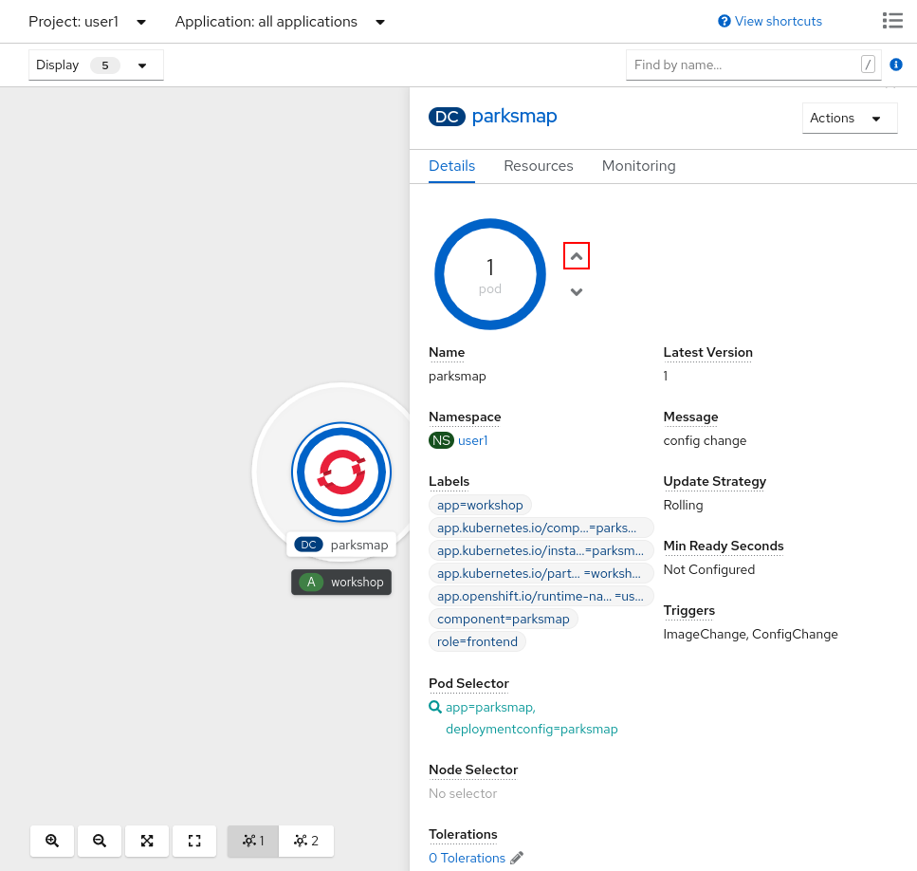
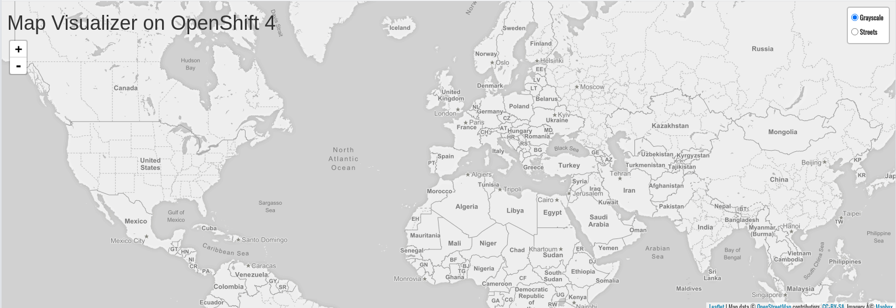
Parksmap: Exploring OpenShift
Scaling Apps
Logging
Labels
Permissions
Accessing and debugging Containers
Notes:
The Frontend will be deployed as a Container Image in an agnostic way, during the deployment students will explore OpenShift functionalities and concepts.

Slide 41
OpenShift 101
Frontend
Create from Container image
Scale the application
Self Healing
Route
Logs
Permissions
Connecting to a Container
Backend
Create from Source to Image (s2i)
Database
Create from Container image
Create a database user with the proper settings and roles
Create a Secret
Update Environment Variables for the backend
Fix Mongodb and Backend labels
Load data into the Db
Notes:
OpenShift automatically creates a few special service accounts in every project. The default service account is responsible for running the Pods, and OpenShift automatically injects this service account into every Pod that is launched.
oc policy add-role-to-user view -z default
oc label route nationalparks type=parksmap-backend

Slide 42
OpenShift 101
Frontend
Create from Container image
Scale the application
Self Healing
Route
Logs
Permissions
Connecting to a Container
Backend
Create from Source to Image (s2i)
Database
Create a Secret
Create from Container image
Create a database user with the proper settings and roles
Create a Secret
Update Environment Variables for the backend
Fix Mongodb and Backend labels
Load data into the Db
Notes:
OpenShift automatically creates a few special service accounts in every project. The default service account is responsible for running the Pods, and OpenShift automatically injects this service account into every Pod that is launched.
oc policy add-role-to-user view -z default
oc label route nationalparks type=parksmap-backend

Slide 43
OpenShift 101
Frontend
Create from Container image
Scale the application
Self Healing
Route
Logs
Permissions
Connecting to a Container
Backend
Create from Source to Image (s2i)
Database
Create from Container image
Create a database user with the proper settings and roles
Create a Secret
Update Environment Variables for the backend
Fix Mongodb and Backend labels
Load data into the Db
Notes:
OpenShift automatically creates a few special service accounts in every project. The default service account is responsible for running the Pods, and OpenShift automatically injects this service account into every Pod that is launched.
oc policy add-role-to-user view -z default
oc label route nationalparks type=parksmap-backend

Slide 44
GitOps
Notes:
Before we start the workshop, we’ll provide a brief introduction to Kubernetes and OpenShift.
The instructor can demo any of kubectl commands here, rather than having all the attendees follow along. Those commands can also be skipped in the interest of time.
Introduction to Kubernetes and OpenShift
Why do we need Kubernetes?
Overview of what Kubernetes is and what it is not
Interacting with Kubernetes via the API and kubectl
Overview of basic Kubernetes resources
What is OpenShift and how does it relate to Kubernetes?

Slide 45



What is GitOps?
ArgoCD
Overview
GitOps is a set of practices that leverages Git workflows to manage infrastructure and application configurations. By using Git repositories as the source of truth, it allows the DevOps team to store the entire state of the cluster configuration in Git so that the trail of changes are visible and auditable.
Desired State
GitOps Controller
Final State

Slide 46


Benefits of using a GitOps Model
ArgoCD
Deploy faster / Innovation Velocity
Developer Centric
Quick and Easy Recovery (Mean Time To Recover - MTTR)
Secure / Separation of Concerns CI - CD
+%
Auditability / Audit Log outside of Cluster
Rollout based on PRs / Rollback with Revert
Code is Reviewed
Observability / Single Source of Truth & Detect Config Drifts
Increase Stability and Reliability

Slide 47

ArgoCD
Argo CD is a declarative, GitOps continuous delivery tool for Kubernetes.
ArgoCD

Slide 48



ArgoCD Kubernetes Objects Generator
ArgoCD
Manifests and third-party integrations
Helm
Kustomize
Kubernetes Manifests
Helm uses a packaging format called charts. A chart is a collection of files that describe a related set of Kubernetes resources
Template-free way to customize application configuration that simplifies the use of off-the-shelf applications
Plain text kubernetes object located in YAML or JSON format

Slide 49



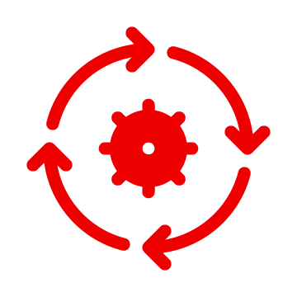

Application Delivery Model on OpenShift
ArgoCD
OpenShift Builds
OpenShift Pipelines
Source Git Repository
Image Registry
Pull Request
OpenShift GitOps
Push
Config Git Repository
Pull

Slide 50
Continuous Integration
ArgoCD
OpenShift Builds
OpenShift Pipelines
Source Git Repository
Image Registry
Pull Request
OpenShift GitOps
Push
Config Git Repository
Pull

Slide 51
Continuous Deployment
ArgoCD
OpenShift Builds
OpenShift Pipelines
Source Git Repository
Image Registry
Pull Request
OpenShift GitOps
Push
Config Git Repository
Pull

Slide 52
Quickly show a Pipeline
Notes:
Before we start the workshop, we’ll provide a brief introduction to Kubernetes and OpenShift.
The instructor can demo any of kubectl commands here, rather than having all the attendees follow along. Those commands can also be skipped in the interest of time.
Introduction to Kubernetes and OpenShift
Why do we need Kubernetes?
Overview of what Kubernetes is and what it is not
Interacting with Kubernetes via the API and kubectl
Overview of basic Kubernetes resources
What is OpenShift and how does it relate to Kubernetes?

Slide 53
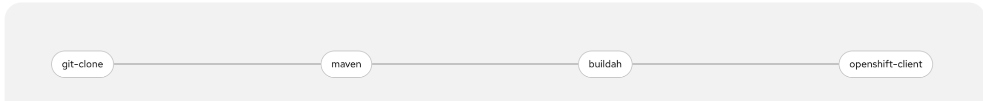
Tekton Pipeline - Build and Deploy
Clone the Repo
Build the app
Create a container & push to internal Openshift repository
Deploy the container

Slide 54
Back to GitOps
Notes:
Before we start the workshop, we’ll provide a brief introduction to Kubernetes and OpenShift.
The instructor can demo any of kubectl commands here, rather than having all the attendees follow along. Those commands can also be skipped in the interest of time.
Introduction to Kubernetes and OpenShift
Why do we need Kubernetes?
Overview of what Kubernetes is and what it is not
Interacting with Kubernetes via the API and kubectl
Overview of basic Kubernetes resources
What is OpenShift and how does it relate to Kubernetes?

Slide 55


The GitOps Application Delivery Model
ArgoCD
CI
Source Git Repository
Image Registry
Pull Request
CD
Push
Config Git Repository
Pull
Monitor
Deploy
Detect drift
Take action
Notes:
Desired state Reconcile

Slide 56
Demo
GitOps

Slide 57
OpenShift 101
GitOps to deploy Everything
Frontend
Create from Container image
Scale the application
Self Healing
Route
Logs
Permissions
Connecting to a Container
Git
Backend
Create from Source to Image (s2i)
Database
Create from Container image
Create a database user with the proper settings and roles
Create a Secret
Update Environment Variables for the backend
Fix Mongodb and Backend labels
Load data into the Db
Notes:
OpenShift automatically creates a few special service accounts in every project. The default service account is responsible for running the Pods, and OpenShift automatically injects this service account into every Pod that is launched.
oc policy add-role-to-user view -z default
oc label route nationalparks type=parksmap-backend

Slide 58


OpenShift 101
Summary
OpenShift
Dashboard
Create from
Container image
S2i
Scale the application
Self Healing
Route
Logs
Service Accounts
Connecting to a Container terminal
Labels
Pipelines: Tekton
Continuous Integration
GitOps: ArgoCD
Continuous Deployment
Notes:
OpenShift automatically creates a few special service accounts in every project. The default service account is responsible for running the Pods, and OpenShift automatically injects this service account into every Pod that is launched.
oc policy add-role-to-user view -z default
oc label route nationalparks type=parksmap-backend

Slide 59
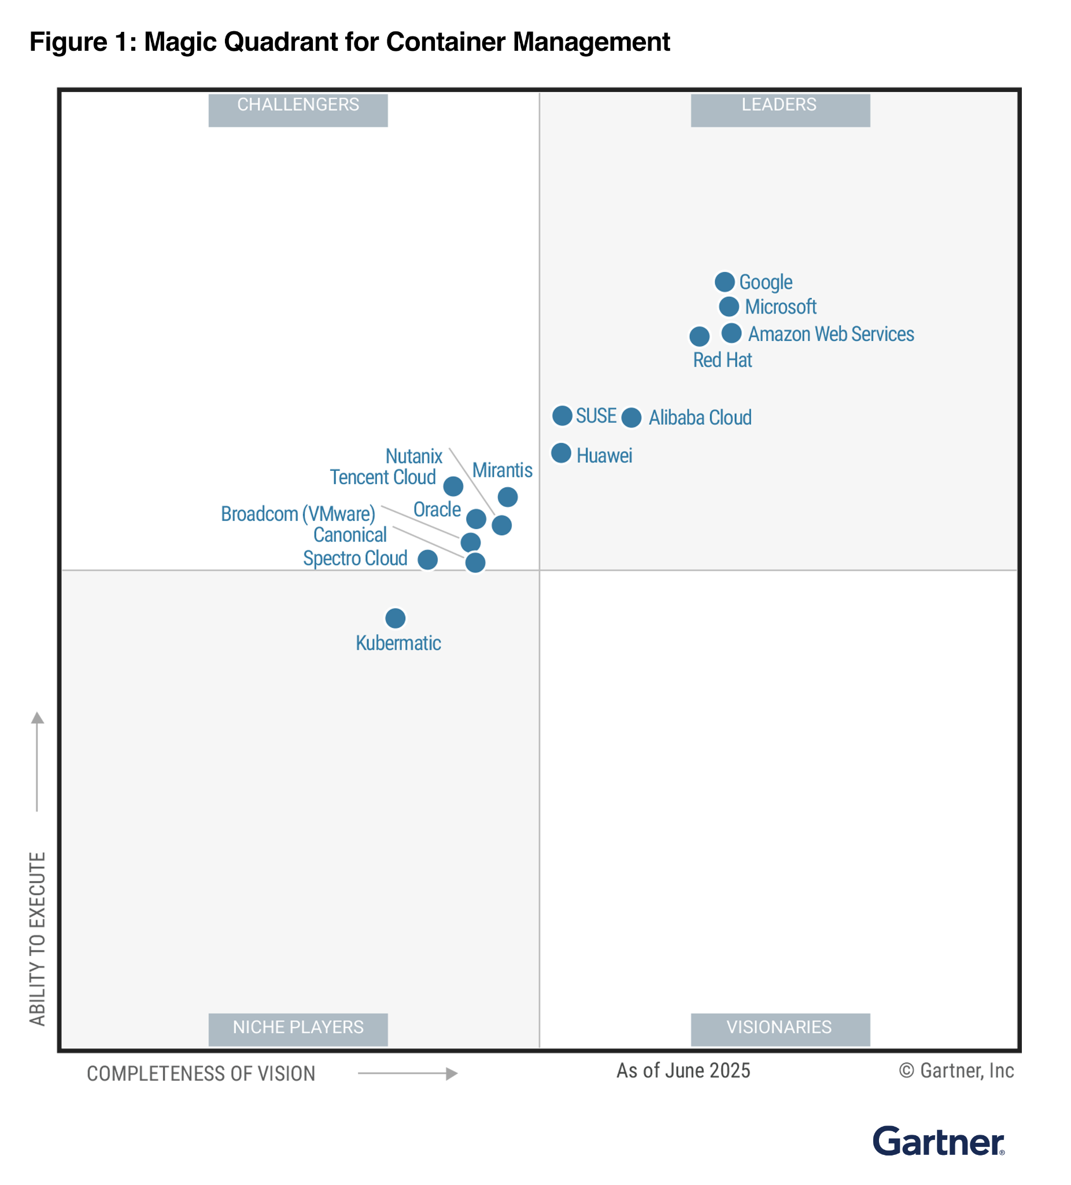
Red Hat is recognized as a Leader in the 2025 Gartner® Magic Quadrant™ for Container Management for the third year in a row
“By 2028, 95% of new AI deployments will use Kubernetes, up from less than 30% today.”
GARTNER is a registered trademark and service mark of Gartner and Magic Quadrant is a registered trademark of Gartner, Inc. and/or its affiliates in the U.S. and internationally and are used herein with permission. All rights reserved. This graphic was published by Gartner, Inc. as part of a larger research document and should be evaluated in the context of the entire document. The Gartner document is available upon request from Red Hat. Gartner does not endorse any vendor, product or service depicted in its research publications, and does not advise technology users to select only those vendors with the highest ratings or other designation. Gartner research publications consist of the opinions of Gartner research organization and should not be construed as statements of fact. Gartner disclaims all warranties, express or implied, with respect to this research, including any warranties of merchantability or fitness for a particular purpose.
Gartner, “Magic Quadrant for Container Management,” Dennis Smith, Tony Iams, Wataru Katsurashima, Michael Warrilow, Richard Watson, 6 August 2025.
Notes:
Red Hat reprint: https://www.redhat.com/en/resources/gartner-magic-quadrant-cloud-application-platforms-analyst-report NOTE: This slide is APPROVED approved by Gartner. Please use as is and do not modify in any way.

Slide 60
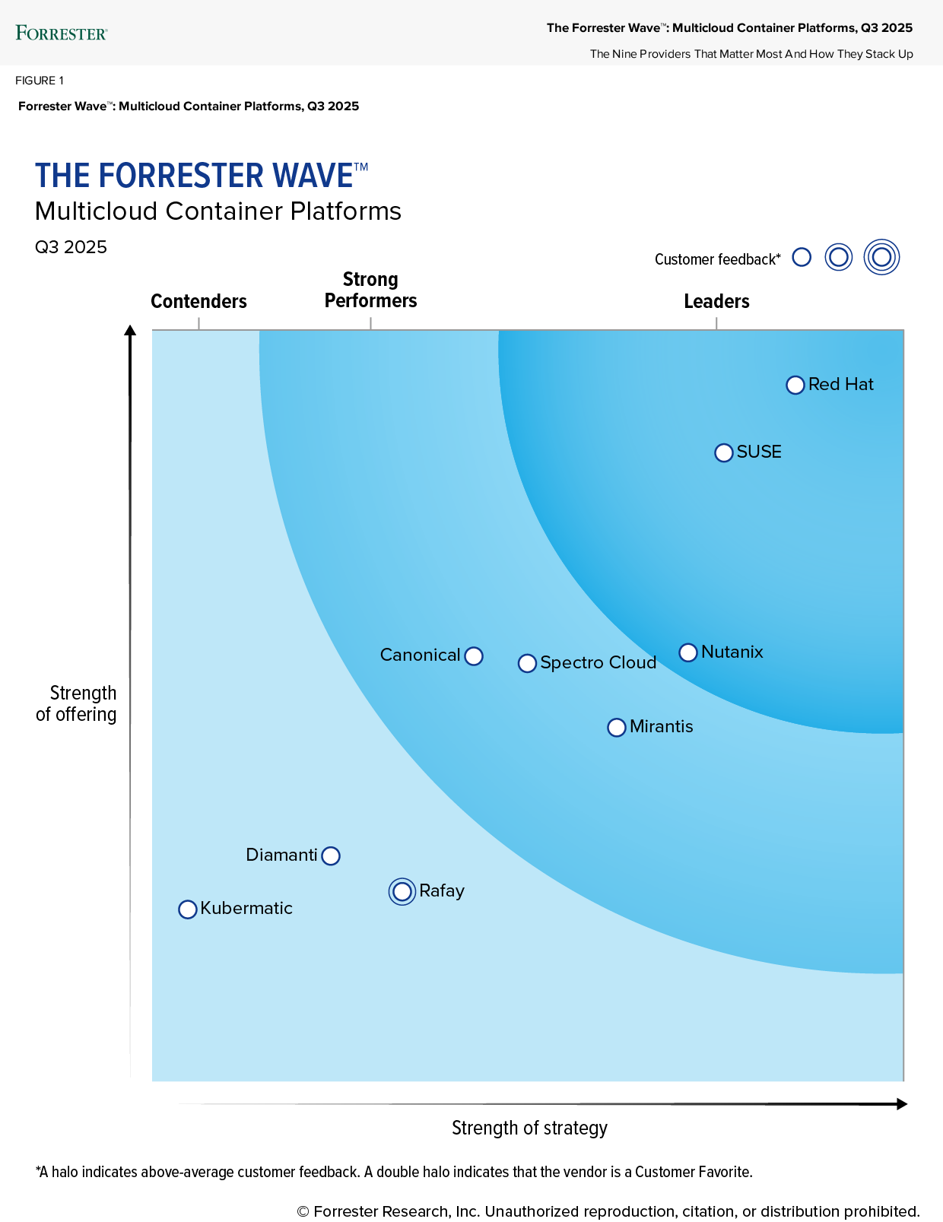
The Forrester Wave™: Multicloud Container Platforms, Q3 2025
“Red Hat’s strong execution has kept it among the top players in [the MCP] market.”
The report calls out “…high-value offerings like OpenShift AI and OpenShift Virtualization as a VMware alternative.”
“Red Hat excels in core Kubernetes areas, offering robust operator options, powerful management, GitOps automation, and flexible interfaces via a GUI or command-line interface (CLI).”
“OpenShift is a good fit for enterprises that prioritize support, reliability, and advanced engineering, particularly in regulated industries such as financial services.”
The Forrester Wave™: Multicloud Container Platforms, Q3 2025
Forrester does not endorse any company, product, brand, or service included in its research publications and does not advise any person to select the products or services of any company or brand based on the ratings included in such publications. Information is based on the best available resources. Opinions reflect judgment at the time and are subject to change. For more information, read about Forrester’s objectivity here .
Notes:
Red Hat is a Leader in The Forrester Wave™: Multicloud Container Platforms, Q3 2025, scoring highest in 27 of 31 criteria in the report.
OpenShift is praised for support, reliability, and advanced engineering, especially in regulated industries and for managed services.
Red Hat excels in core Kubernetes, offering robust operators, management, GitOps, and flexible interfaces.
Red Hat offers high-value offerings like OpenShift AI for development and operations as well as OpenShift Virtualization as a VMware alternative
This slide is NOT APPROVED by Forrester. Please see conditions of use below.
USING THESE SLIDES: Approved slides have been created and have been added to the OpenShift Customer Deck found here. Please note that the slide with the graphic can ONLY be shown LIVE to customers per Forrester policy. You cannot leave it behind with a customer in printed or PDF format. Please instead send the customer one of links (Download page *captures lead data* or Direct download link *does not capture lead data*).
NOTE: If you are recording a webinar or another live presentation that will be available for on-demand viewing after the fact, you need Forrester approval to include the Wave graphic. Please send the entire slide presentation, including the approved Wave graphic slide, along with the title, abstract, and date of the webinar to analystrelations@redhat.com. Forrester requires 48 hours to review, so please allow plenty of time for this approval process.

Slide 61


OpenShift 101
Summary
OpenShift
Dashboard
Create from
Container image
S2i
Scale the application
Self Healing
Route
Logs
Service Accounts
Connecting to a Container terminal
Labels
Pipelines: Tekton
Continuous Integration
GitOps: ArgoCD
Continuous Deployment
Notes:
OpenShift automatically creates a few special service accounts in every project. The default service account is responsible for running the Pods, and OpenShift automatically injects this service account into every Pod that is launched.
oc policy add-role-to-user view -z default
oc label route nationalparks type=parksmap-backend

Slide 62
OpenShift 101
Summary
OpenShift
Dashboard
Create from
Container image
S2i
Scale the application
Self Healing
Route
Logs
Service Accounts
Connecting to a Container terminal
Labels
Pipelines: Tekton
Continuous Integration
GitOps: ArgoCD
Continuous Deployment
Notes:
OpenShift automatically creates a few special service accounts in every project. The default service account is responsible for running the Pods, and OpenShift automatically injects this service account into every Pod that is launched.
oc policy add-role-to-user view -z default
oc label route nationalparks type=parksmap-backend

Slide 63
OpenShift 101
Summary
OpenShift
Dashboard
Create from
Container image
S2i
Scale the application
Self Healing
Route
Logs
Service Accounts
Connecting to a Container terminal
Labels
Pipelines: Tekton
Continuous Integration
GitOps: ArgoCD
Continuous Deployment
Notes:
OpenShift automatically creates a few special service accounts in every project. The default service account is responsible for running the Pods, and OpenShift automatically injects this service account into every Pod that is launched.
oc policy add-role-to-user view -z default
oc label route nationalparks type=parksmap-backend

Slide 64
Thank you
Red Hat is the world’s leading provider of enterprise open source software solutions. Award-winning support, training, and consulting services make Red Hat a trusted adviser to the Fortune 500.

